Slide 1

MISSIONREADY AI™
MissionReady AI™
Visual evidence. Human judgment. Equipment readiness.
LaShea Conner-Gaten, Ed.M.
Founder & CEO, CAI Collective Group
San Diego Military Summit 2026
CAI Collective Group
01
Notes:
SLIDE 1 · 0:00–0:30. Play the 24.3-second AI twin, then say: That was my digital twin. I’m LaShea Conner-Gaten, and I built this. [CLICK]
The twin is a presentation tool, separate from the inspection model.

Slide 2
01 Clarity of the Business and Problem
LaShea Conner-Gaten
Founder & CEO, CAI Collective Group
Former Deloitte Chief of Staff
$25M portfolio pipeline
2026 Salesforce AI Fluency Rising Star
Lovable AI Solutions Partner — Certified Web & App Builder
AI governance, change management and Agile delivery
CAI Collective Group
02
Notes:
SLIDE 2 · 0:30–1:05.
CAI Collective is a Black woman-owned AI strategy and technology firm in San Diego. At Deloitte, I managed a $25 million portfolio pipeline supporting clients representing $1.8 trillion in combined revenue. I’m certified in AI governance, change management and Agile delivery, and a certified Lovable web and app builder. I received Salesforce’s 2026 AI Fluency Rising Star award for Fair Chance Orbit. My doctoral work at USD focuses on responsible AI in cybersecurity and defense. [CLICK]
Founder-supplied background. Award applies to Fair Chance Orbit. Lovable credential: AI Solutions Partner — Certified Web & App Builder.

Slide 3
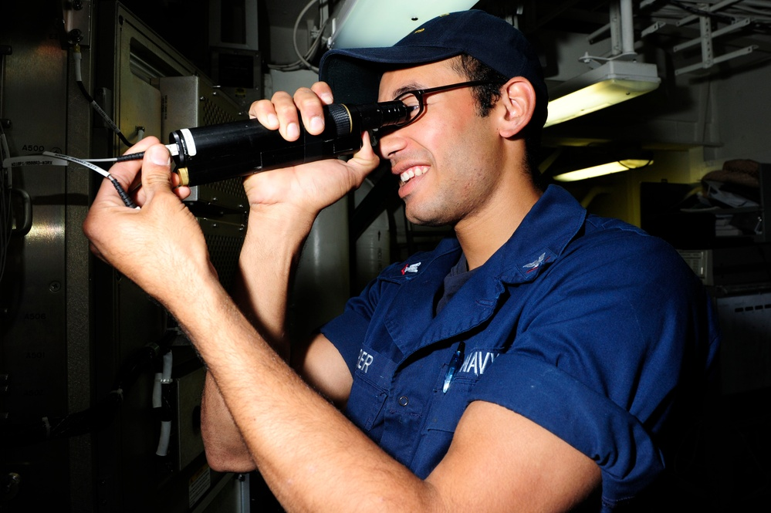
01 Clarity of the Business and Problem
A missing tool can delay the whole job
Missing tools
Manual follow-up
Delayed assignments
Reference photo: U.S. Navy / A.J. Jones, 2012
CAI Collective Group
03
Notes:
SLIDE 3 · 1:05–1:30.
Picture a technician starting a shift. An adapter is damaged. The kit is incomplete. The job waits while someone checks spreadsheets, photos and messages. Our initial buyers are maintenance and defense-support organizations. Their tool managers need to know what they have, who has it, and what genuinely needs replacing. Every unresolved handoff takes time away from the work.
Photo source: https://www.dvidshub.net/image/776371/uss-farragut-sailor-inspects-cable. Reference image, not a customer or endorsement.

Slide 4
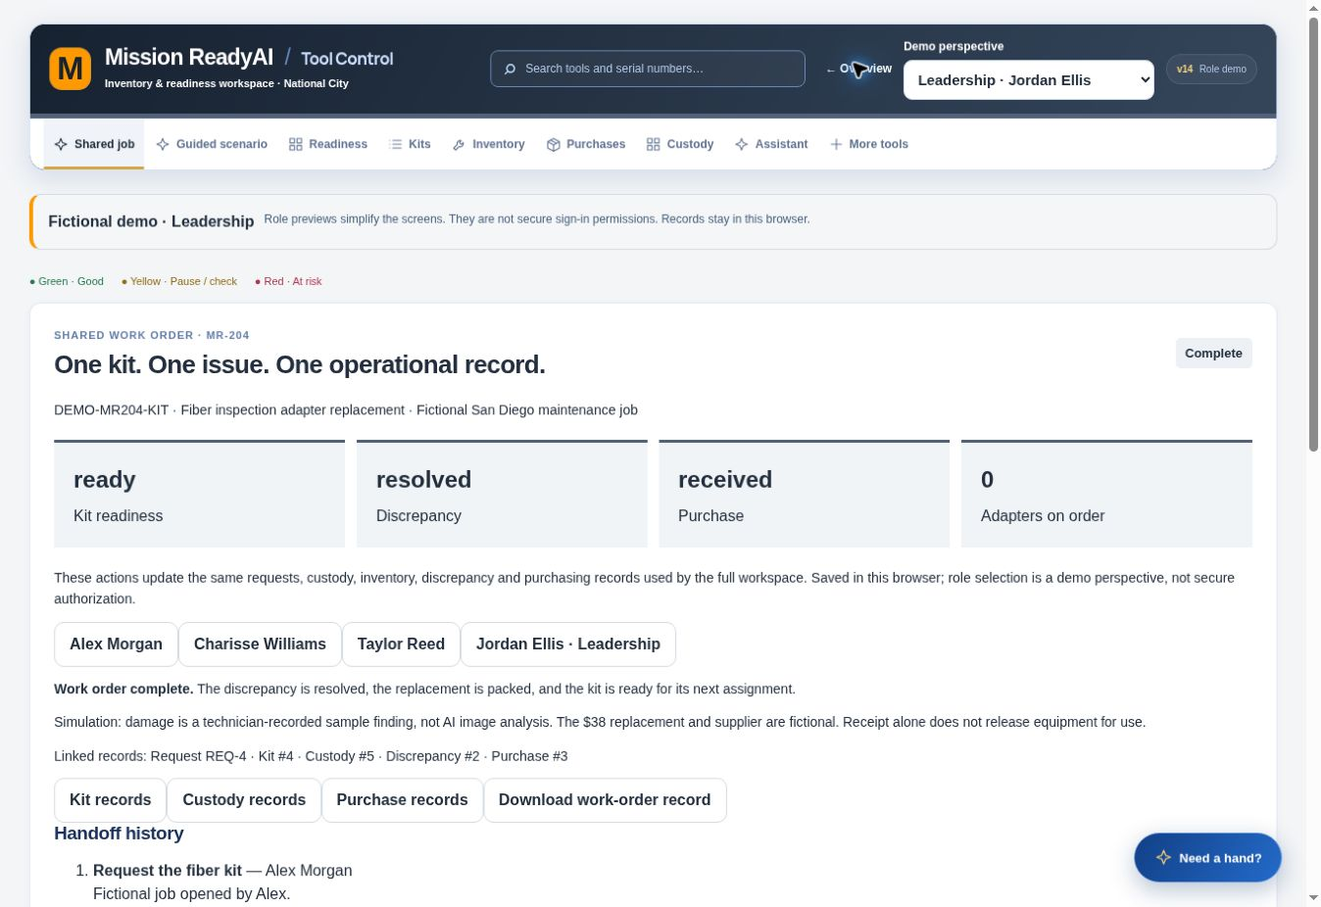
02 Strength and Practicality of the AI Use Case
A working operational foundation
ONE KIT
ONE ISSUE
ONE SHARED RECORD
Working prototype. AI integration next.
CAI Collective Group
04
Notes:
SLIDE 4 · 1:30–1:50.
I designed and built the prototype, informed by a kSARIA Tool & Logistics Specialist who participated as an individual user and tester. This is not an organizational pilot or endorsement. The application now connects a fictional job across the technician, tool room, purchasing and leadership. The next step is connecting reviewed image findings to these records.
Source: application and verified v14 app. Records are browser-local; secure cloud access is not active.

Slide 5
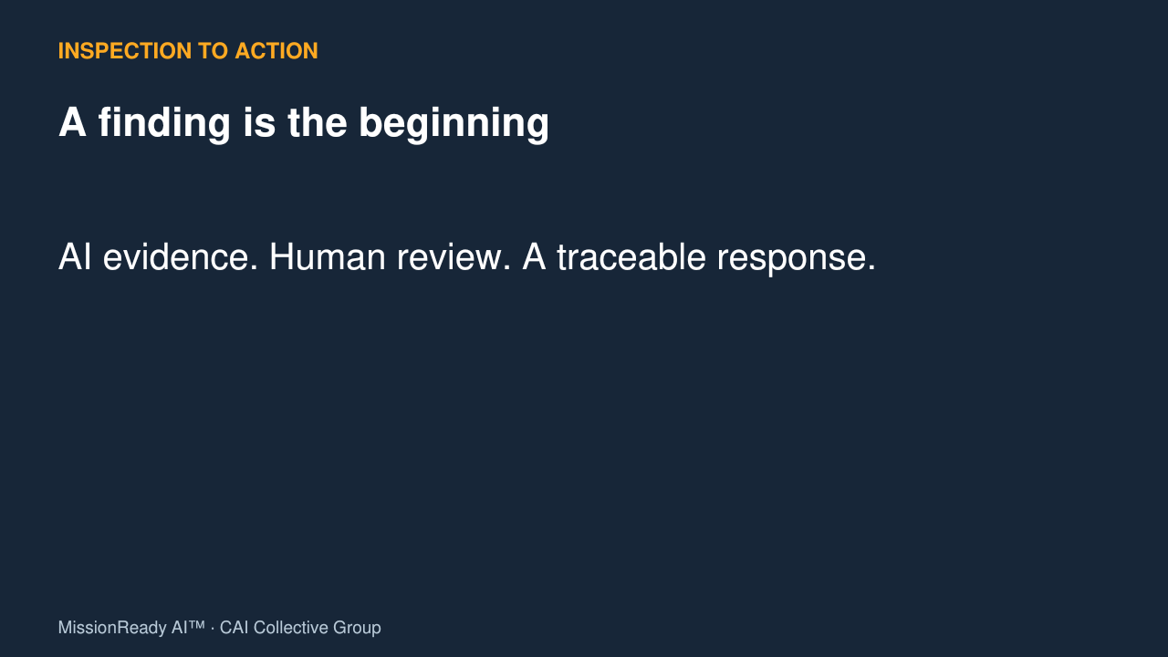
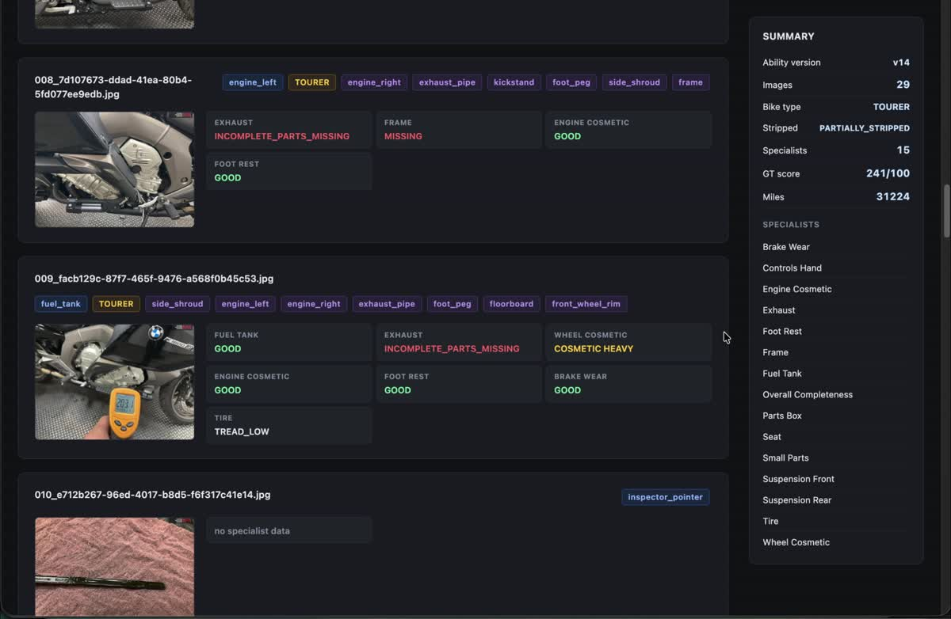
02 Strength and Practicality of the AI Use Case
The inspection-to-action experience
61-second silent demonstration
Inspection reference
Working prototype
Phase 2 concept
CAI Collective Group
05
Notes:
SLIDE 5 · 1:50–2:51. Silent video plays automatically.
0–4 seconds: Watch how visual evidence can become an actionable record.
4–18 seconds: This motorcycle inspection reference from Andy Ballester shows the image-analysis approach we want to adapt and validate for supported tools and kits.
18–38 seconds: Here is the working prototype. The same job connects kit readiness, custody, discrepancies and purchasing. People own the decisions. Image findings are the next integration step.
38–61 seconds: Phase 2 would suggest findings and repair steps from approved documentation for qualified review. A repair proposal includes evidence, parts, estimated cost and time. Leaders approve the work, and the record tracks return to service. These final screens illustrate planned capabilities. [CLICK]
Reference is not a validated fiber model or live MissionReady AI integration. Actual application screenshot sequence: https://mission-readyai-v1.vercel.app/mission-readyai-v14/. Source video: Andy Ballester’s shared Motorcycle Inspection reference. Backup: MissionReady-AI-Demo.mp4.

Slide 6
03 Potential and Measurable Business Impact
Measurable pilot targets
30–50%
50%
less kit-verification time
less report-preparation time
484 hours / year
≈ $24,360 / team / year
Phase 2 scenario: $165,000 / year across 50 technicians
Planning estimates. Baselines and assumptions require pilot validation.
CAI Collective Group
06
Notes:
SLIDE 6 · 2:51–3:25.
Our pilot targets are 30 to 50 percent less kit-verification time and 50 percent less reporting time. The Phase 1 model estimates 484 hours recovered annually per team, with about $24,360 in capacity value and purchasing savings. Ten comparable teams would represent about $243,600. Our Phase 2 planning scenario adds $165,000 across 50 technicians. These are estimates. We will measure verification time, AI accuracy, discrepancy resolution and purchasing outcomes. [CLICK]
Phase 1 assumptions: 40 checks/day × 5 minutes × 22 days/month × 12 months × 40% improvement, plus 1 reporting hour/day × 22 × 12 × 50% = 484 hours/year. $40/hour = $19,360 capacity value. Hypothetical 5% of $100,000 tooling spend = $5,000. Total $24,360, excludes implementation, subscription and cloud cost. Phase 2 $165,000 supplied by founder; supporting calculation not provided in this session. Treat as unvalidated scenario, not proven or additive without checking overlap.

Slide 7
04 Feasibility of Implementation on AWS
AWS supports the inspection workflow
01
02
03
04
STORE
PROCESS
REVIEW
UPDATE
Images in S3
Model integration
Lambda
Human decision
Step Functions
Shared records
Cognito controls access throughout
6 work packages / 200–330 estimated hours
Proposed architecture and effort. Subject to technical review.
CAI Collective Group
07
Notes:
SLIDE 7 · 3:25–4:00.
We are seeking $25,000 in AWS and Futran services. The prototype provides the operational foundation, and a separate image-recognition component is available for integration and evaluation. Our proposed AWS architecture uses S3 for images, Cognito for access, and Lambda with Step Functions to coordinate processing and human review. Our planning scope is six work packages and an estimated 200 to 330 hours. We will confirm architecture, effort and priorities together. [CLICK]
Architecture is proposed, not deployed. The six-work-package/200–330-hour estimate is founder-supplied and requires engineering review, not a vendor commitment. Scope must fit awarded services. Image-model runtime and data-handling requirements remain to be evaluated. Source: submitted application and founder’s current script.

Slide 8
05 Readiness to Execute in the Next 30–90 Days
Ready to execute in 90 days
DAYS 1–30
DAYS 31–60
DAYS 61–90
Scope + permissions
Baseline measures
Connect image AI
Test human review
Measure results
Decide next phase
Founder-led delivery. Organizational licensing; target $30,000 annually.
CAI Collective Group
08
Notes:
SLIDE 8 · 4:00–4:40.
I will serve as executive sponsor and product owner. Days one through thirty establish supported kit scope, data permissions and baseline measures. Days thirty-one through sixty connect image results to human review and operational records. Days sixty-one through ninety test accuracy, review frequency, processing cost and business outcomes. CAI also has a signed PCMA engagement with a planned November 16 launch. Our commercial model is organizational licensing, with a target average annual license of $30,000. Customer value and pricing will need validation at the intended deployment scale.
Source: submitted application. License is a target, not contracted revenue. The illustrative one-team savings alone do not establish ROI for this license price.

Slide 9
05 Readiness to Execute in the Next 30–90 Days
The foundation is built
The next milestone is a validated Phase 1 pilot.
A working foundation
A focused 90-day pilot
Come try MissionReady at my table
$25,000 in AWS / Futran services
CAI Collective Group
09
Notes:
SLIDE 9 · 4:40–5:00.
We are asking for $25,000 in AWS and Futran services to validate the next phase. I’ve built the strategy. I’ve built the product. Now I’m ready to lead the pilot. Come try it at my table. MissionReady AI: equipped teams, faster repairs, ready missions. Thank you.
Source: submitted application. Salesforce award applies to Fair Chance Orbit, not MissionReady AI. PCMA is a separate engagement. Optional invitation after time permits: Come try the connected demo at my table.

